Slide 1
Chapter 22
Inflation and Hyperinflation

Slide 2
Introduction
Hyperinflation refers to period of massive price growth
Prices grow so rapidly that the payment system is damaged to the point of shutdown
Too much money has been printed → outward push of AD dominates all else in our macroeconomic models
During ordinal times the link between money and inflation is much looser

Slide 3
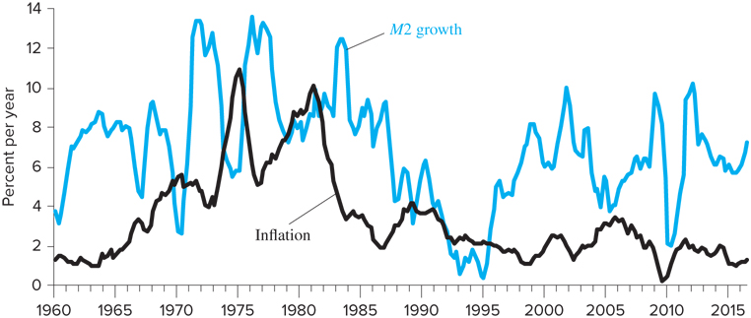
Money and Inflation in Ordinary Business Cycles
Figure shows annual M2 growth and the inflation rate of the GDP deflator for the U.S.

Slide 4
Money and Inflation in Ordinary Business Cycles
How do you think M1 has changed during the Great Depression???

Slide 5
Money and Inflation in Ordinary Business Cycles
Inflation closely linked to M2 growth, but relationship not as strong between inflation and M1
TABLE 22-1 Money, Inflation, and Output Growth (Percent per year)
 | M1 | M2 | GDP Growth | Inflation*
1960-1969 | 3.7 | 7.0 | 4.5 | 2.3
1970-1979 | 6.4 | 9.5 | 3.4 | 6.5
1980-1989 | 7.8 | 7.9 | 3.2 | 4.7
1990-1999 | 3.6 | 4.0 | 3.4 | 2.2
2000-2009 | 4.1 | 6.4 | 1.7 | 2.3
2010-2016 | 10.3 | 6.3 | 2.1 | 1.6
1960-2016 | 5.7 | 6.9 | 3.1 | 3.4
*Based on the GDP deflator.
Source: Federal Reserve Economic Data [FRED] and authors’ calculations.

Slide 6
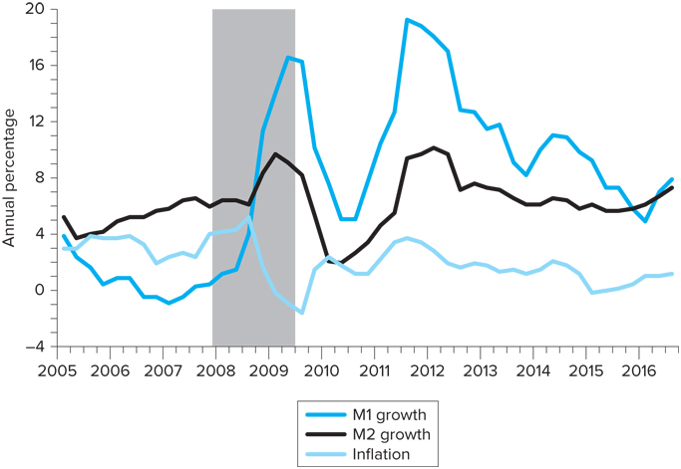
Money and Inflation in Ordinary Business Cycles
During Great Recession money growth and inflation unrelated, why???

Slide 7
TABLE 22-2 Money and Inflation in International Perspective, 1960–2011 (Percent per Year)
 | Money Growth* | Output Growth | “Predicted” Inflation | Actual Inflation
Canada** | 9.4 | 3.5 | 5.9 | 4.2
France*** | 5.9 | 2.1 | 3.7 | 5.3
Italy*** | 11.8 | 2.6 | 9.2 | 9.6
Japan | 10.5 | 4.1 | 6.4 | 3.4
United Kingdom | 11.4 | 2.4 | 9.0 | 5.8
United States | 7.7 | 3.1 | 4.6 | 4.0
*M1 plus quasi-money.
**For 1960–2008, later data being unavailable for broad money aggregates.
***For 1978–1998 only, previous or later data being unavailable for broad monetary aggregates.
Notes:
Source: IMF, International Financial Statistics, 2011

Slide 8
Hyperinflation
Hyperinflation: very high rates of inflation → around 1,000 percent per annum
In a hyperinflationary economy, inflation is so pervasive that is dominates daily economic life.
Venezuela Hyperinflation Crisis
https://www.youtube.com/watch?v=dwZ6B5kalbQ
Notes:
Source: IMF, International Financial Statistics, 2011

Slide 9
Stopping Hyperinflation
All hyperinflations come to an end…
The government finds a way of reforming its budget process
Often a new money is introduced and the tax system is reformed
Often exchange rate of a new currency is pegged to that of a foreign currency to provide an anchor for prices and expectations
Frequently there are unsuccessful attempts at stabilization before the final success

Slide 10
Stopping Hyperinflation
Often a coordinated attack on hyperinflation:
Heterodox approach to stabilization
Monetary, fiscal, and exchange rate policies combined with income policies (to establish wages below free market equilibrium level)
Israel and Mexico

Slide 11
Disinflation and the Sacrifice Ratio
Cost of inflation reduction = a recession, but what exactly is the tradeoff?
Sacrifice ratio: ratio of the cumulative percentage loss of GDP to the reduction in inflation that is actually achieved
Before the disinflation of the 1980s, economists estimated sacrifice ratios of proposed disinflation programs between 5 and 10, with the actual value was estimated to be 1.83 (Laurence Ball)

Slide 12
Deficits, Money Growth, and the Inflation Tax
What is the link between budget deficits and inflation?
Some argue that money growth is the result of government budget deficits
The federal government can finance the deficit in two ways:
Sell bonds
“Print money” → Fed prints money when it increases the stock of high-powered money

Slide 13
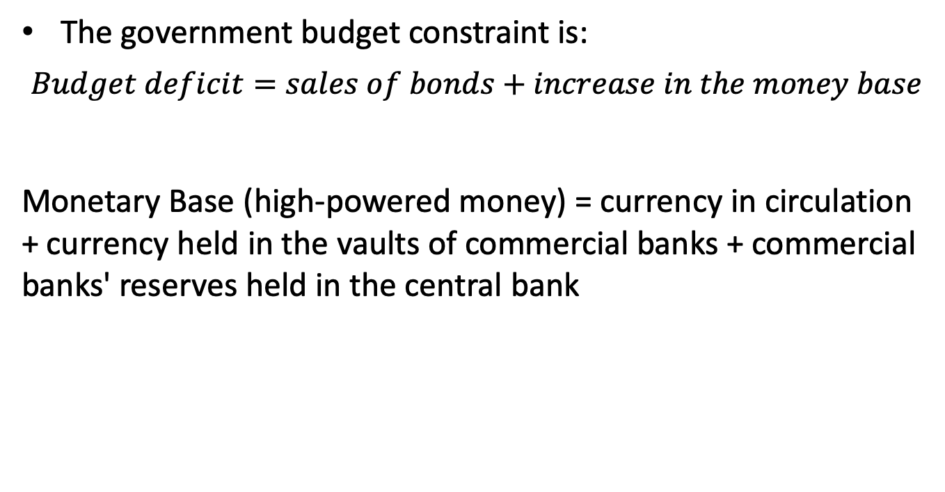
Deficits, Money Growth, and the Inflation Tax
The government budget constraint is:
$$Budget deficit=sales of bonds+increase in the money base$$
Monetary Base (high-powered money) = currency in circulation + currency held in the vaults of commercial banks + commercial banks' reserves held in the central bank

Slide 14
Deficits, Money Growth, and the Inflation Tax
There are two types of possible links between budget deficits and money growth:
In the short run, an increase in the deficit caused by expansionary fiscal policy will tend to raise nominal and real interest rates
Can you use IS-LM model to explain this???
The government may deliberately be increasing the stock of money as a means of financing itself over the long run

Slide 15
Deficits, Money Growth, and the Inflation Tax
Monetization of deficits is an alternative to explicit taxation
As the government creates money to finance the deficit, the public is willing to increase its holdings of nominal money balances.
Why ?
The public increases money holdings to offset the effects of inflation OR to maintain a constant level of real holdings
Inflation can act like a tax because people are forced to spend less than their income.

